Slide 1

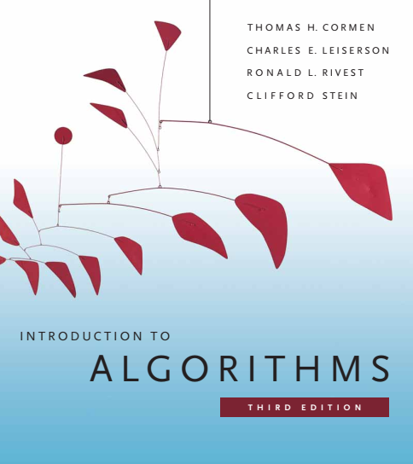
Design and Analysis of Algorithms
Dr. Sajid Iqbal
sajidiqbal.pk@gmail.com
Reference Book
Introduction to Algorithms 3rd Edition By Thomas H. Cormen et. al.
https://mitpress.mit.edu/books/introduction-algorithms-third-edition
COMEDXD

Slide 2
Solving Recursion
Recursion Tree method

Slide 3
Recurrence Solving Methods
Substitution Method
Recursion Tree Method
Master Theorem Method
1
2
3

Slide 4

Recurrence Relations
Recurrence Relations can be written as
Binary Search: $T(n)=T(n/2)+c$
Merge Sort: $T(n)=2T\left(\frac{n}{2}\right)+n$
A function that is written in terms of itself with smaller input size
Other examples are
Fibonacci Number: $Fn = F_{n−1} + F_{n−2}$
Logistic map: $x_{n+1}=rx_{n}(1−x_{n})$
Feed forward IIR combo filter: $y_{t}=\left(1−α\right)x_{t}+αy_{t}−T$
Recursion could be polynomial, exponential or some other function
Try to write two functions in each class given above

Slide 5


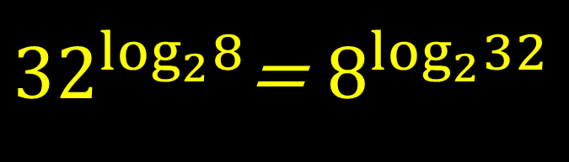
Log Rule
${32}^{\log_{2}8}$= $8^{\log_{2}32}$
LHS
${32}^{\log_{2}{8}}$
${32}^{3}$
$32768$
RHS
$8^{\log_{2}{32}}$
$8^{5}$
32768

Slide 6
Recursion tree method
Technicalities in recurrences:
We will assume even size of input even it is odd for simplicity
Solving Recursion
A recurrence is solved using recursive method however when problem is of smallest size, direct method of evaluation is used. We will ignore direct method cost when solving recursion
This method converts recurrence into a tree
The tree nodes represent the costs incurred at various levels
We use techniques for bounding summations to solve the recurrence.
Each node represents the cost of a single subproblem
We sum the costs within each level of the tree to obtain a set of per-level costs
Then we sum all the per-level costs to determine the total cost of all levels of the recursion.

Slide 7
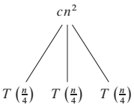
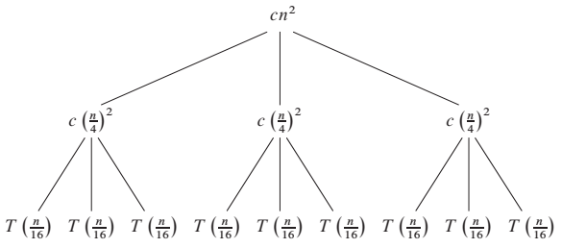

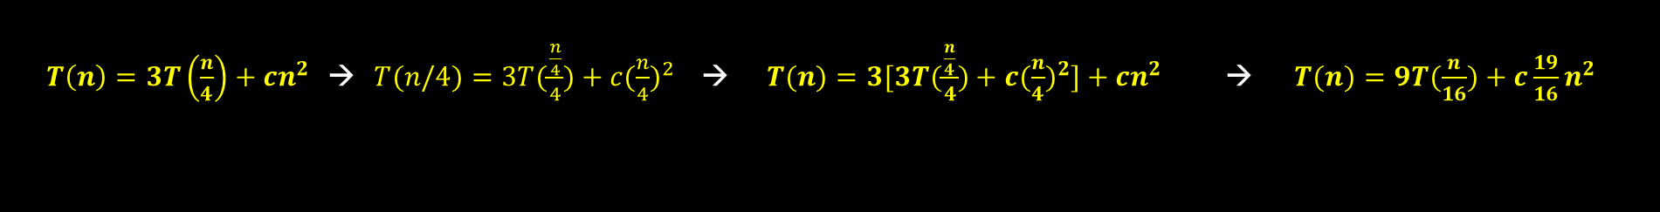
$$T\left(n\right)=3T\left(\frac{n}{4}\right)+θ\left(n^{2}\right)=3T\left(\frac{n}{4}\right)+cn^{2}$$
we assume that $n$ is an exact power of 4
$T\left(n\right)=3T\left(\frac{n}{4}\right)+cn^{2}$ → $T(n/4)=3T(\frac{\frac{n}{4}}{4})+c{(\frac{n}{4})}^{2}$ → $T(n)=3[3T(\frac{\frac{n}{4}}{4})+c{(\frac{n}{4})}^{2}]+cn^{2}$ → $T(n)=9T(\frac{n}{16})+c\frac{19}{16}n^{2}$

Slide 8
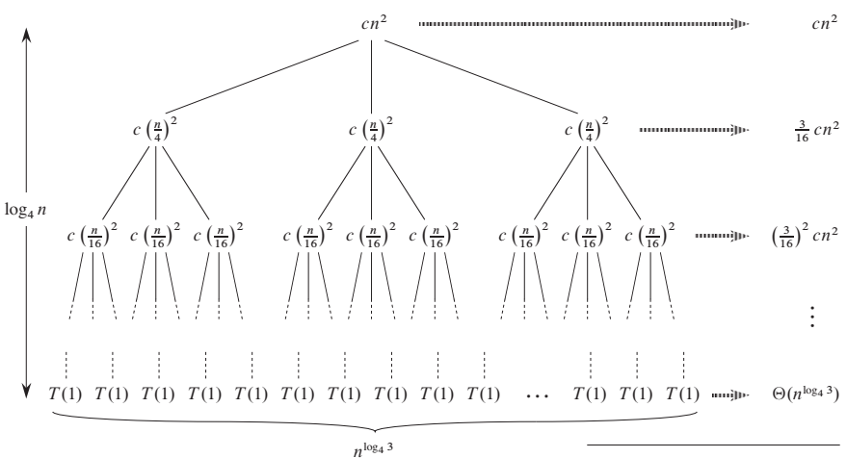


Slide 9

Recursion Tree Explanation
Every time problem is reduced by the factor of 4
$n,\frac{n}{4},\frac{n}{4^{2}},\frac{n}{4^{3}},……,\frac{n}{4^{i}} → n,\frac{n}{4},\frac{n}{16},\frac{n}{64},……\frac{n}{n}$
$\frac{n}{4^{i}}=1 →log_{4}n=i$
The tree has depth $0,1,2,3,…,i → log_{4}n+1$
Now we determine cost of execution at each level
At level $i$ there are $3^{i}$ nodes
at level $0$ there $3^{0}$, at level $1, 3^{1}$nodes …
Cost of each node at a level is given by $c{\left(\frac{n}{4^{i}}\right)}^{2}$
Cost of $ith$ level is $3^{i}c{\left(\frac{n}{4^{i}}\right)}^{2} → 3^{i}c\left(\frac{n^{2}}{{16}^{i}}\right)→$ $\frac{3^{i}cn^{2}}{16^{i}}→{\left(\frac{3}{16}\right)}^{i}cn^{2}$

Slide 10

Recursion Tree Explained
At level $i$ there are $3^{i}$ nodes i.e. $3^{0},3^{1},3^{2},…$ till second last level i.e. $n−1$
Last level has the depth $\log_{4}n$
Number of nodes at last level is also $3^{i}$ or $3^{\log_{4}n}$ $∴\frac{n}{4^{i}}=1 →log_{4}n=i$
According to log laws $3^{\log_{4}n}=n^{\log_{4}{3}}$
Each node costs 1 time so total cost is at last level
$3^{\log_{4}{n}}∗T\left(1\right)→n^{\log_{4}{3}}T\left(1\right)→n^{\log_{4}{3}}→θ(n^{\log_{4}{3}})$

Slide 11
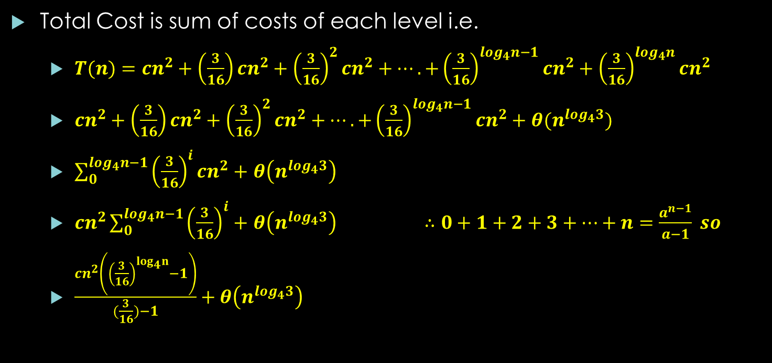
Recursion Tree Explained
Total Cost is sum of costs of each level i.e.
$T(n)=cn^{2}+\left(\frac{3}{16}\right)cn^{2}+{\left(\frac{3}{16}\right)}^{2}cn^{2}+….+{\left(\frac{3}{16}\right)}^{log_{4}n−1}cn^{2}+{\left(\frac{3}{16}\right)}^{log_{4}n}cn^{2}$
$cn^{2}+\left(\frac{3}{16}\right)cn^{2}+{\left(\frac{3}{16}\right)}^{2}cn^{2}+….+{\left(\frac{3}{16}\right)}^{log_{4}n−1}cn^{2}+θ(n^{log_{4}3})$
$\sum_{0}^{log_{4}n−1}{{\left(\frac{3}{16}\right)}^{i}cn^{2}+}$ $θ\left(n^{log_{4}3}\right)$
$cn^{2}\sum_{0}^{log_{4}n−1}{{\left(\frac{3}{16}\right)}^{i}+}$ $θ\left(n^{log_{4}3}\right)$ $∴0+1+2+3+…+n=\frac{a^{n−1}}{a−1} so$
$\frac{cn^{2}\left({\left(\frac{3}{16}\right)}^{log_{4}n}−1\right)}{(\frac{3}{16})−1}+θ\left(n^{log_{4}3}\right)$

Slide 12

$cn^{2}\sum_{0}^{log_{4}n−1}{{\left(\frac{3}{16}\right)}^{i}+} θ\left(n^{log_{4}3}\right)$
$≤cn^{2}\sum_{0}^{∞}{{\left(\frac{3}{16}\right)}^{i}+} θ\left(n^{log_{4}3}\right)$ $∴a\sum_{0}^{∞}{{\left(r\right)}^{i}}=\frac{a}{1−r}$
$\frac{cn^{2}}{1-\left(\frac{3}{16}\right)} +θ\left(n^{log_{4}3}\right)$
$\left(\frac{16}{13}\right)cn^{2}+θ\left(n^{log_{4}3}\right)$
${cn}^{2}$
$O(n^{2})$

Slide 13
Thanks for watching
Dr. Sajid Iqbal
Assistant Professor
Department of Computer Science
Bahauddin Zakariya University, Multan
Allah Hafiz

